Slide 1

Final Project: UFC Data Analysis
Unlocking Winning Strategies: Data-Driven Insights for Fighters and Coaches
Course Name: ALY 6010 - Probability Theory and Introductory Statistics
Northeastern University: College of Professional Studies
Professor: Antonius Breur
Date: October 31st, 2024
Presented By:
Sriram Kannepalli
https://medium.com/@raphael.schols/the-ultimate-fighting-championship-exploratory-data-analysis-python-1e7c962fe2e8

Slide 2
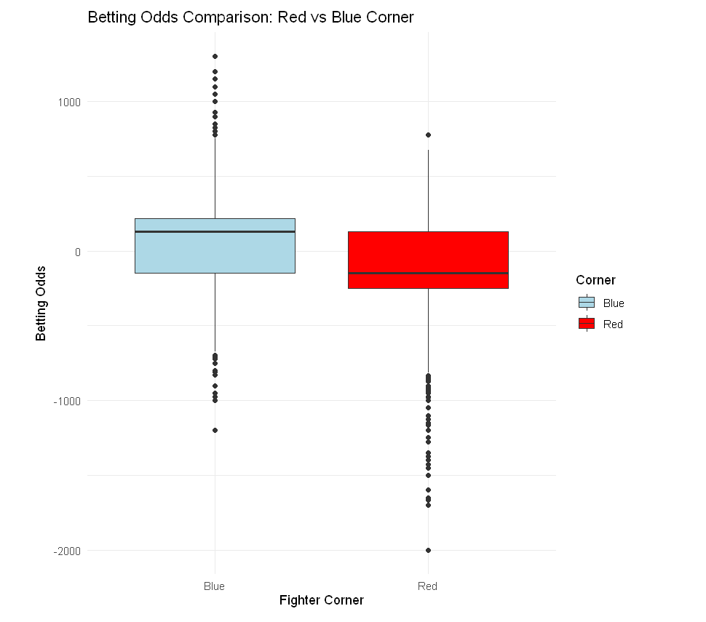
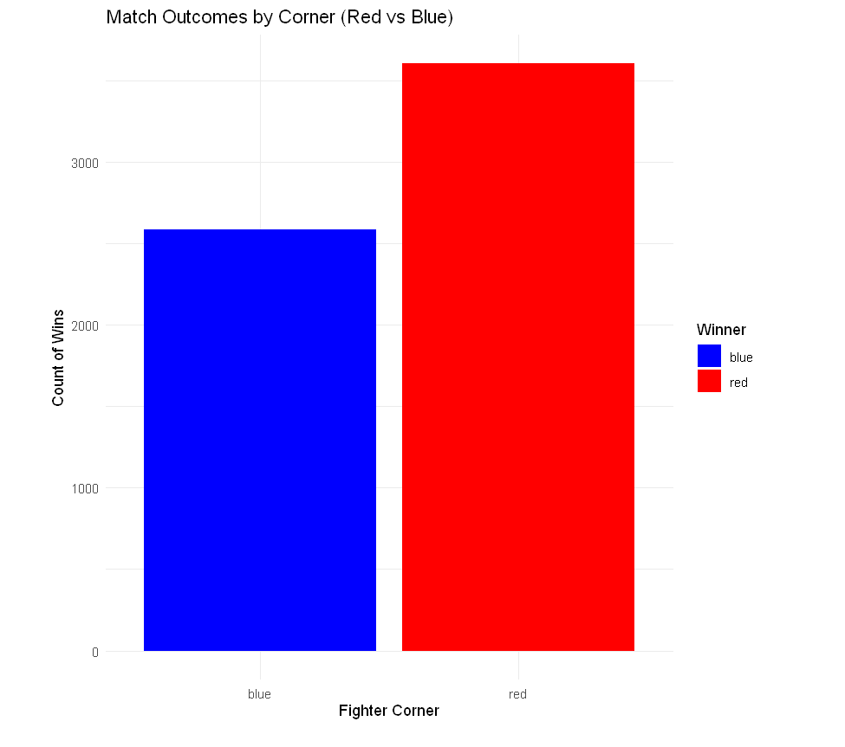
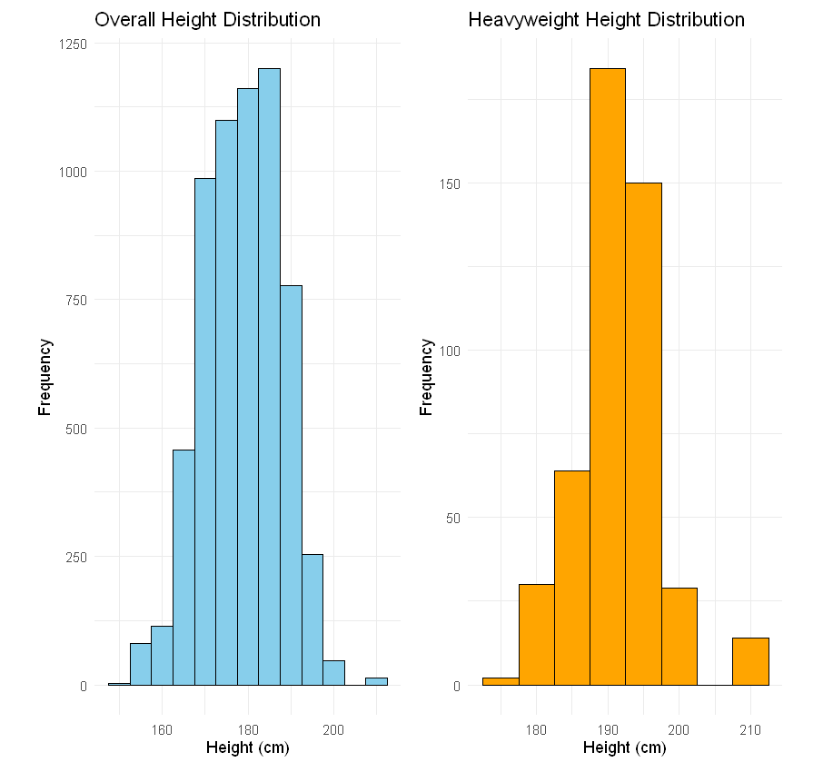
Initial Exploratory Data Analysis
1
Betting Odds Difference
Red corner fighters received more favorable odds.
2
Corner Influence
Red corner had statistically significant advantage in outcomes.
3
Height and Reach
Positive correlation observed between height and reach.

Slide 3
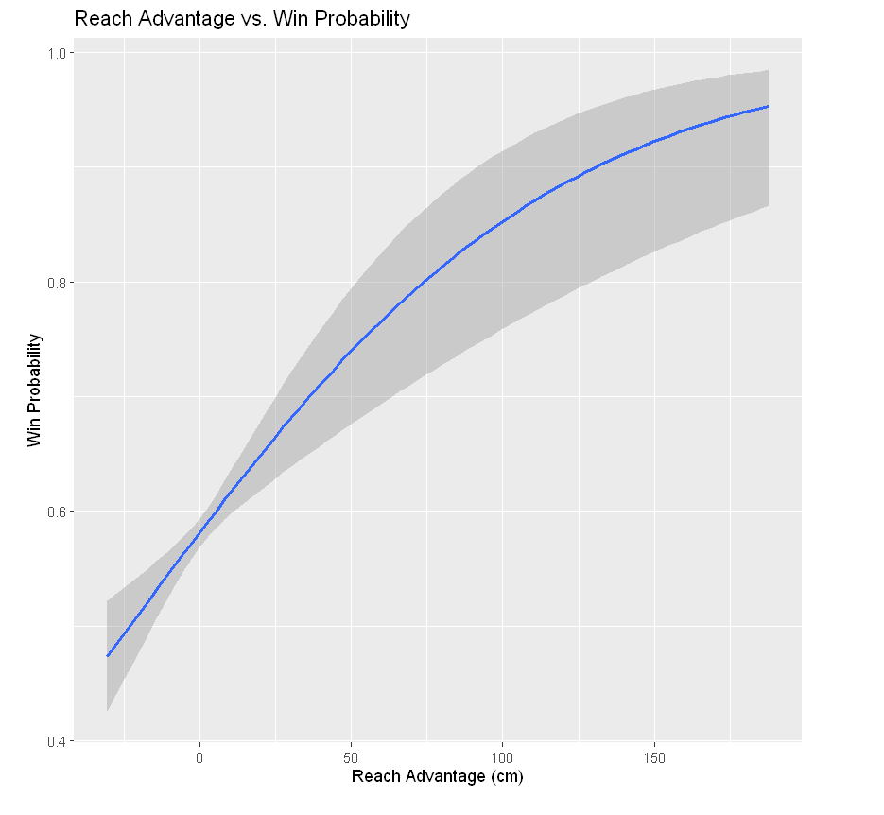



Reach Advantage and Weight Class Impact
Hypothesis
Reach advantage and weight class affect win probability.
Analysis
Logistic regression used to test impact on winning.
Result
Reach advantage significantly increased win probability.

Slide 4
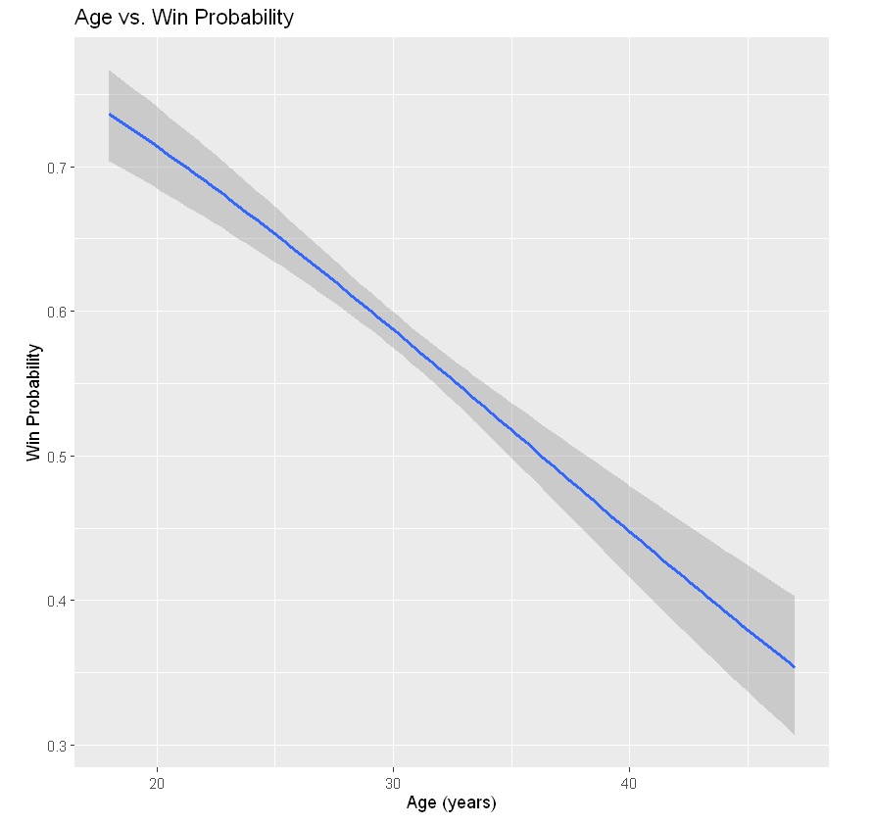
Fighter Age and Experience
1
Hypothesis
Younger age positively affects win probability.
2
Methodology
Logistic regression with age and experience as predictors.
3
Findings
Age negatively impacted win probability; experience not significant.

Slide 5
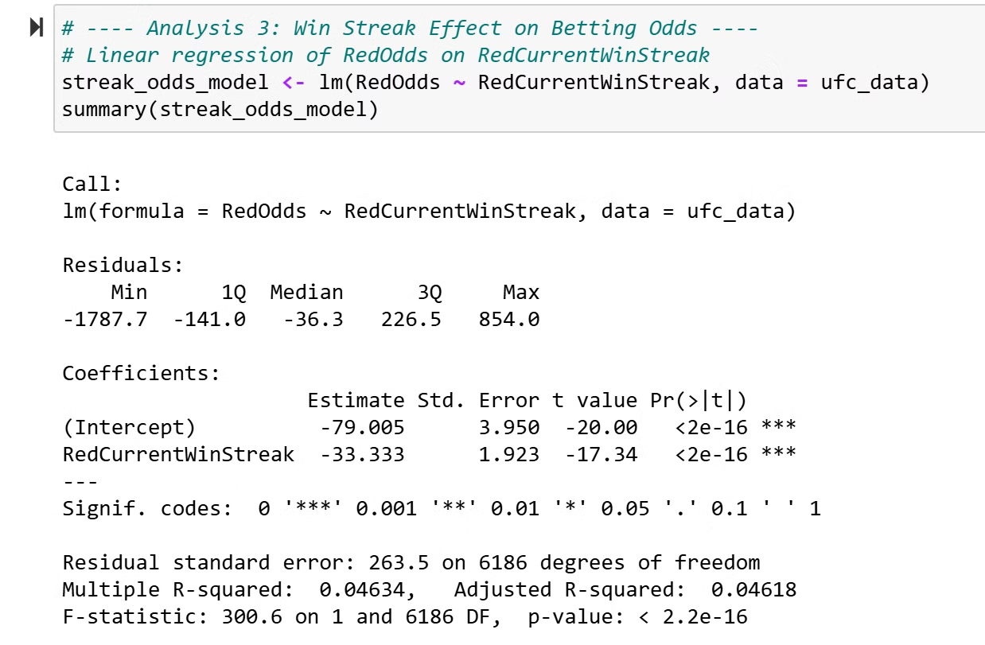
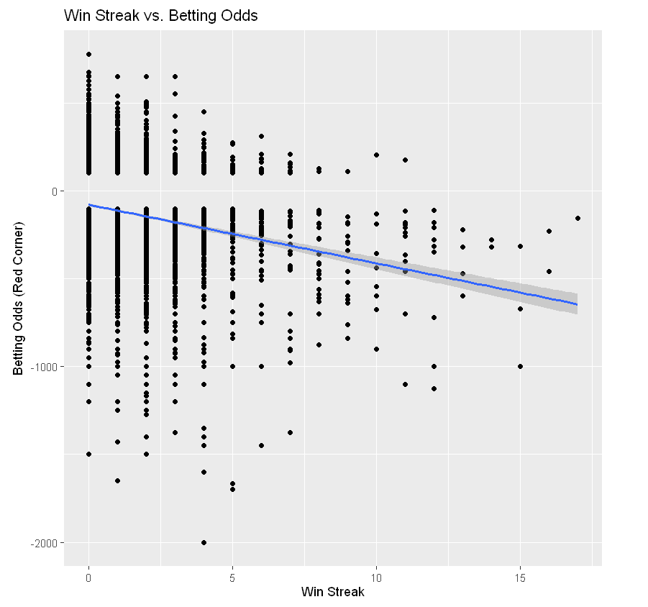
Win Streak Effect on Betting Odds
Hypothesis
Analysis
Result
Longer win streak improves betting odds.
Linear regression: betting odds vs. win streak.
Win streaks associated with more favorable odds.

Slide 6
Results and Interpretation
This analysis highlights the significant impact of three key factors—reach advantage, age, and win streak—on UFC fight outcomes and betting odds. Fighters with greater reach, younger age, and longer win streaks demonstrate distinct advantages that shape the dynamics and perceptions of UFC bouts.
Reach Advantage: Fighters with a greater reach relative to their opponents have a significantly higher probability of winning. This advantage likely allows them to control the distance, strike effectively, and defend more easily. Coaches and fighters should prioritize reach as a strategic asset to enhance both offensive and defensive tactics.
Age Factor: Younger fighters tend to have a higher win probability compared to older fighters, suggesting that physical fitness, agility, and endurance are critical advantages in UFC bouts. Experience alone does not offset the physical edge provided by youth. Older fighters should focus on maximizing efficiency and minimizing energy loss, while younger fighters should capitalize on their physical prime through intense conditioning.
Win Streak and Betting Odds: A longer win streak leads to more favorable (lower) betting odds, reflecting increased confidence from both fans and bookmakers. However, this effect plateaus, indicating that win streaks are only one of many factors shaping public perception and betting odds. Consistent winning boosts a fighter's market value and public confidence, but sustained performance pressure means that mental resilience is also crucial.

Slide 7
Conclusion and Insights
Physical Attributes Matter: Reach advantage and youth are pivotal in determining a fighter's chances of winning. Trainers should focus on reach-based tactics and tailored conditioning programs to maximize these physical assets.
Winning Momentum Influences Public Perception: A fighter's win streak affects their betting odds, underscoring the importance of performance consistency. Fighters on winning streaks should balance media attention with sustained training focus to handle heightened expectations.
Optimizing Strategies: By understanding the impact of reach, youth, and winning consistency, UFC teams can maximize a fighter's potential for success in both the octagon and the public arena.

Slide 8
References
Ultimate UFC Dataset (n.d.). GitHub repository. Accessed on October 25, 2024.
R in action: Data analysis and graphics with R and tidyverse (3rd ed.). Kaba (2022). Manning Publications. Accessed on October 26, 2024.
Predicting UFC matches using regression models. Apelgren, S., & (2024). Degree Project in Technology, First cycle, 15 credits. KTH Royal Institute of Technology. Accessed on October 27, 2024.
Tidy des (n.d.). Tidyverse. Accessed on October 26, 2024. Used for data cleaning and organization principles followed throughout the analysis.

Slide 9
Thank You!

